Slide 1
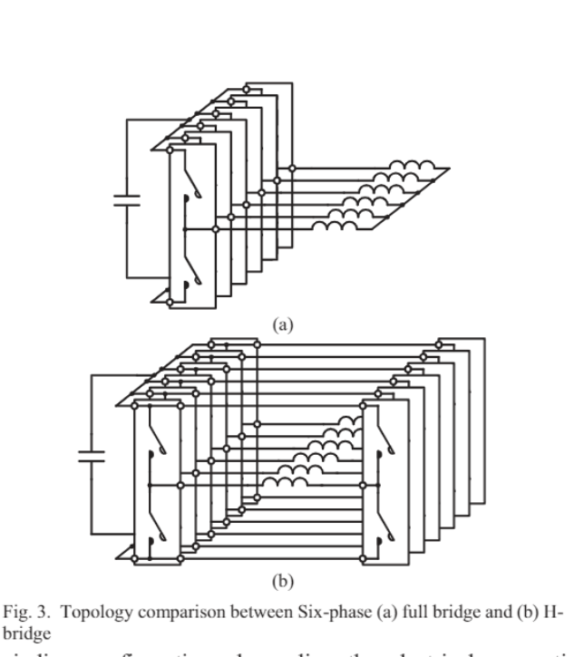
A GaN-Based Integrated Modular Motor Drive for Open-Winding Permanent Magnet Synchronous Motor Application
Capacitor size does not be made a smaller by increasing frequency after a point.
Because the rms value of the inverter is independent of the switching frequency.
Phase Shifting ➔ Cancelling the specific harmonics
H-Bridge Phase Shift ➔ not modular

Slide 2
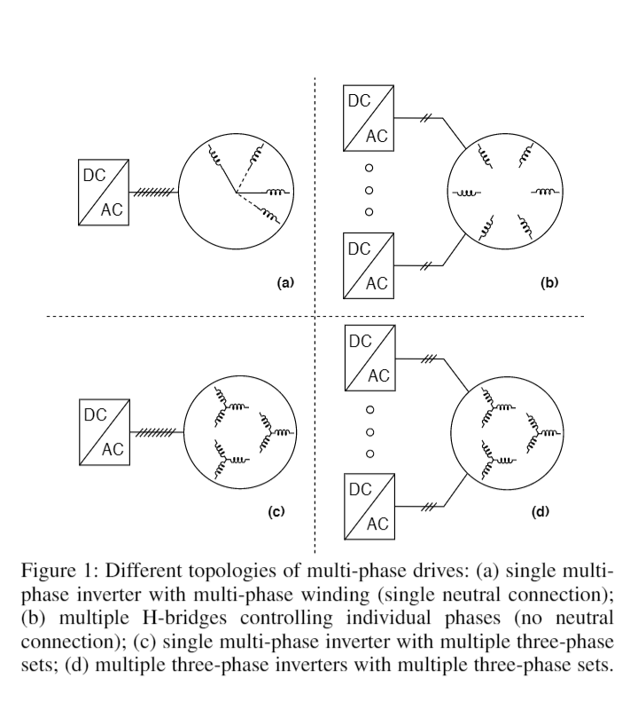
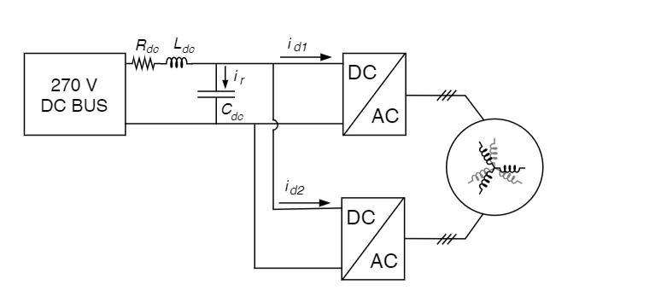
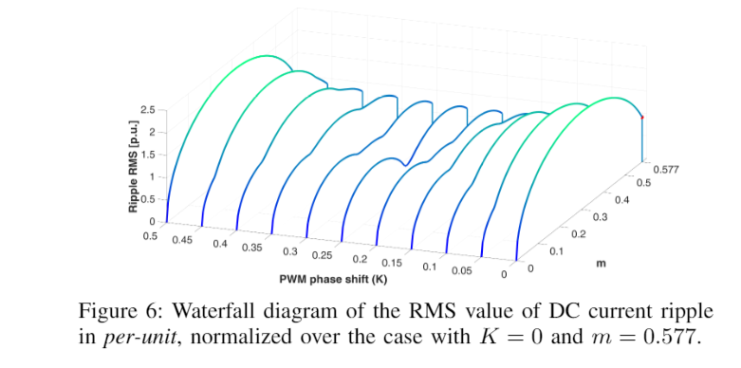

Modular Multi-Three Phase Electric Drives for Enhanced Reliability and Current Ripple Minimization

Slide 3
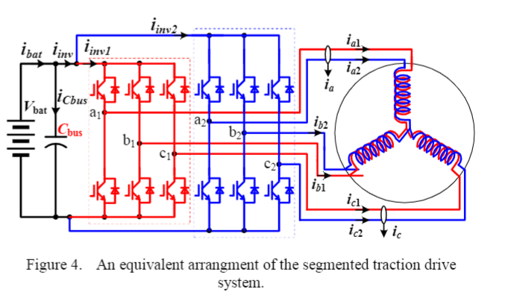
A Segmented Traction Drive System with a Small dc Bus Capacitor
increasing the switching frequency, which is one of the anticipated benefits with future wide-bandgap -based switches, has little impact o n the bus capacitor ripple currents because the capacitor ripple currents depend on the motor peak current, although so increasing switching frequency does reduce the dc bus voltage and motor current ripples, and (2) the major components of the capacitor r ipple currents have frequencies of multiples of the switching frequency or their side bands. The high frequency nature of the ripple currents makes it impractical to actively filter out the ripple components because doing so requires the use of very high switching frequencies in the active filte
Parallel connection

Slide 4
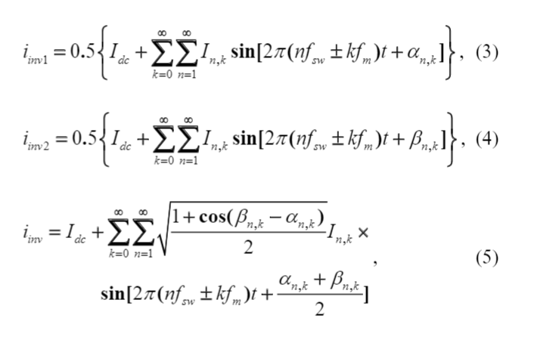
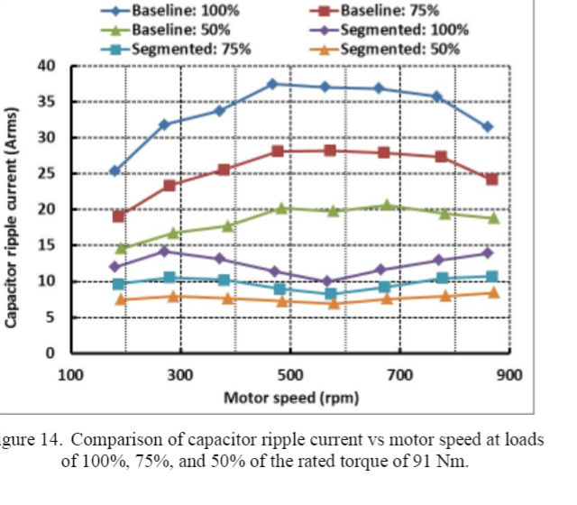
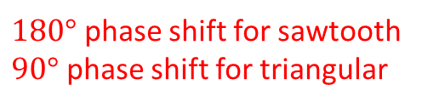
$180°$ phase shift for sawtooth
$90°$ phase shift for triangular
İn IMMD simulations which carrier is used?
Experiment which carrier?

Slide 5
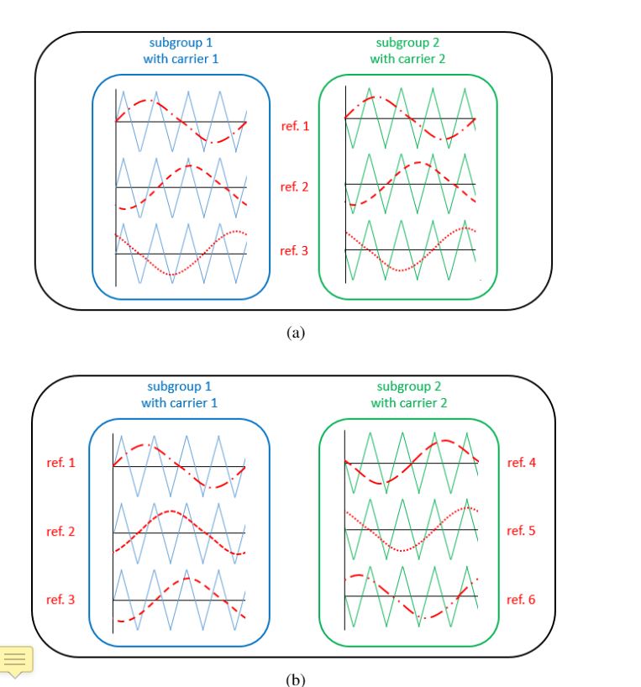
Module Connection Topologies and Interleaving Strategies for Integrated Modular Motor Drives
Belki yapılabilir ama doğru alfa ve beta değerlerini nasıl bulucaz?

Slide 6
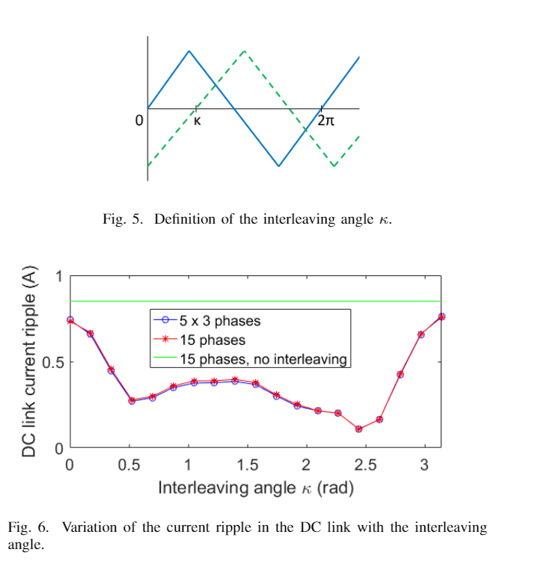
No interleaving dediği kısım aslında k’nın sıfır olduğu yer değil mi?

